Slide 1
Nested Loops
Loopception

Slide 2
Loop in a loop
Just a loop inside a loop
For every time the outer loop runs once, the inner loop will run fully
Commonly for loops
Nested for loops use ‘i’ for the outer loop, ‘j’ for inner loop, then ‘k’ and so on
Nested Loops are difficult to visualise, useful to Rubber Duck!

Slide 3
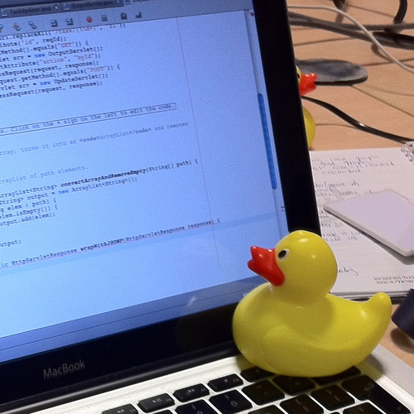
Rubber ducking
The process of explaining a problem to an inanimate object, and in the process of explaining realizing how to solve it
By Tom Morris - Own work, CC BY-SA 3.0, https://commons.wikimedia.org/w/index.php?curid=16745966

Slide 4

Visualisation
//Try and visualise what the below code will do
for(int i=0;i<=3;i++){
for(int j=10;j<=100;j=j+10){
System.out.println(j);
}
}

Slide 5
What happened
Inner Loop
Outer Loop

Slide 6
10x
4x

Slide 7
Print 10 things
3x

Slide 8
Usage of nested loops
Accessing elements in 2d arrays
 | Result0 | Result1 | Result2
Student0 | 60 | 70 | 80
Student1 | 55 | 60 | 85
Student2 | 40 | 70 | 65

